Slide 1
PROJECT SQL

Slide 2
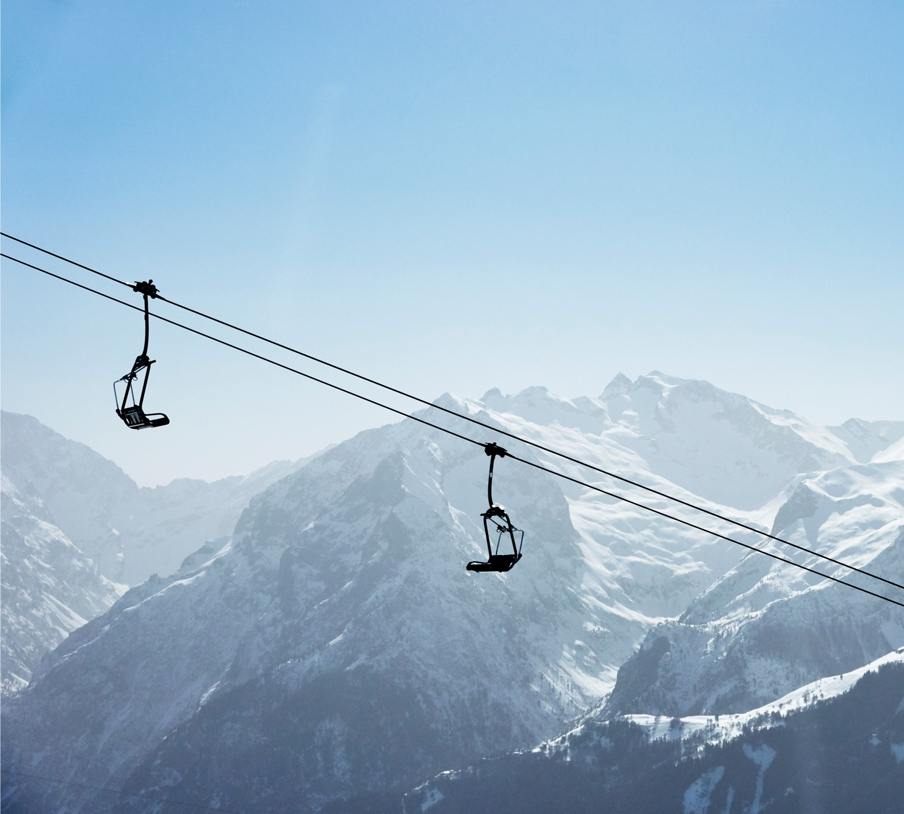
Agenda
Introduction
KPI’s
Answering Questions

Slide 3
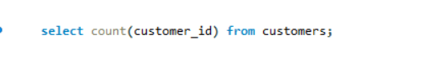
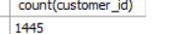
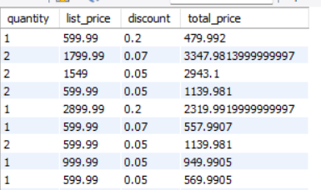
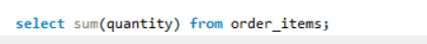
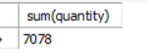
KPI’s
Number of customers:
#
Total price:
#
Total bike sold : #

Slide 4
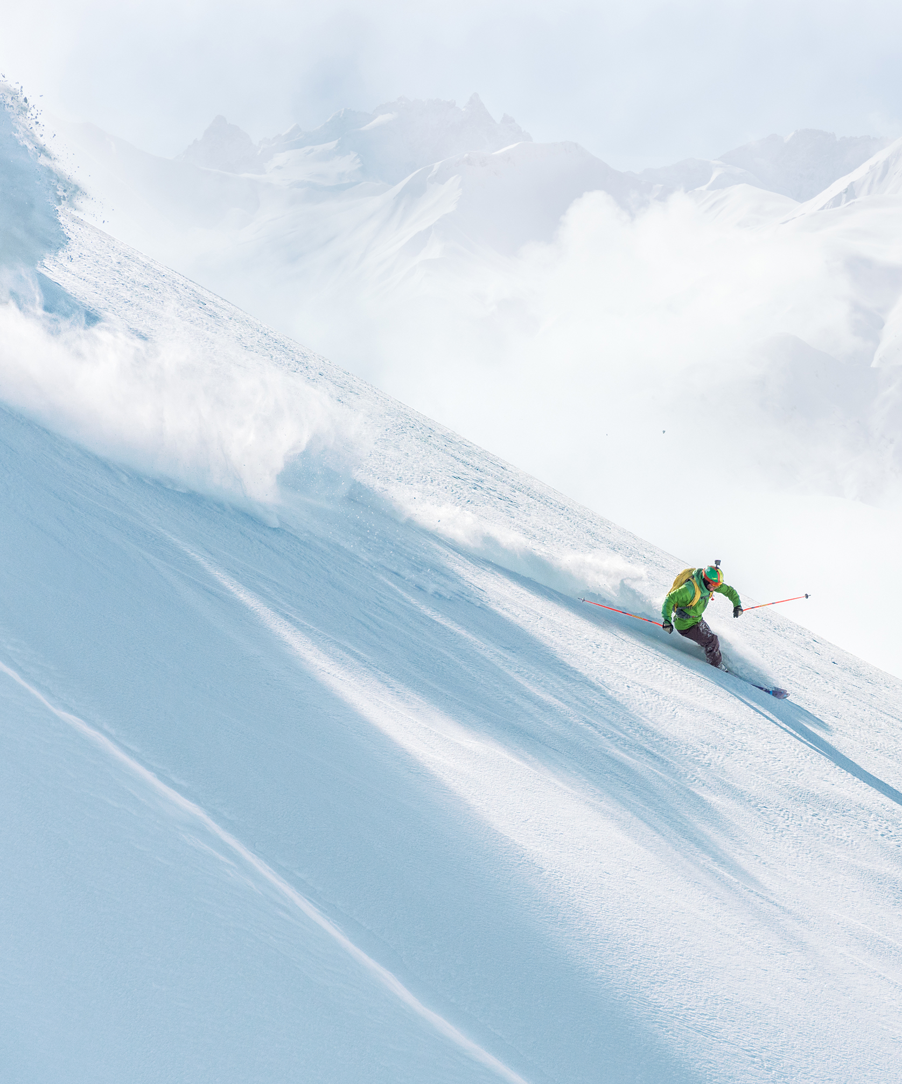
Introduction: This project focuses on utilizing SQL to analyze and extract insights from a dataset centered on a bike store's operations. In this project, I have executed a series of queries that address business questions.

Slide 5
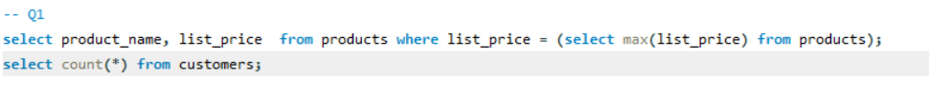
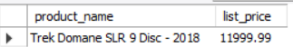
Answering Questions
1-Which bike is most expensive? What could be the motive behind pricing this bike at the high price?
Query:
Result:

Slide 6
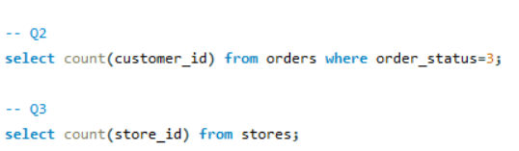
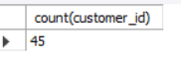
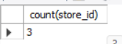
Answering Questions
2-How many total customers does BikeStore have? Would you consider people with order status 3 as customers substantiate your answer?
3-How many stores does BikeStore have?
Query:
Result: Answ2: Answ3:

Slide 7
Answering Questions
4-What is the total price spent per order?
Hint: total price = [list_price] *[quantity]*(1-[discount])
Query:
Result:

Slide 8
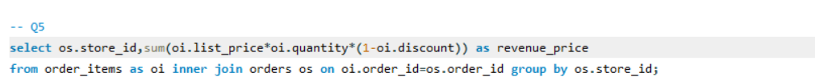
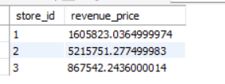
Answering Questions
5-What’s the sales/revenue per store?
Hint: Sales revenue = ([list_price] *[quantity]*(1-[discount]))
Query:
Result:

Slide 9
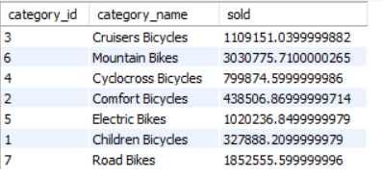
Answering Questions
6-Which category is most sold?
Query:
Result: Answ6:

Slide 10
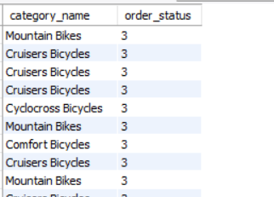
Answering Questions
7-Which category rejected more orders?
Query:
Result:

Slide 11
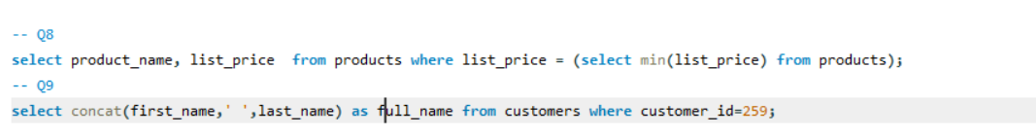
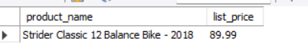
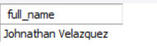
Answering Questions
8-Which bike is the least sold?
9-What’s the full name of a customer with ID 259?
Query:
Result: Answ8: Answ9:

Slide 12
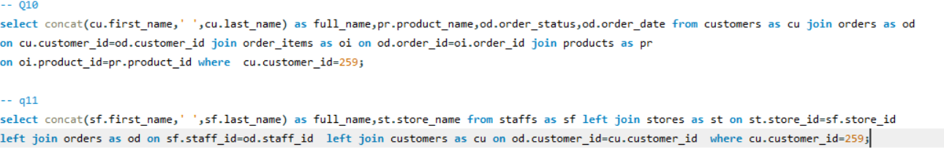
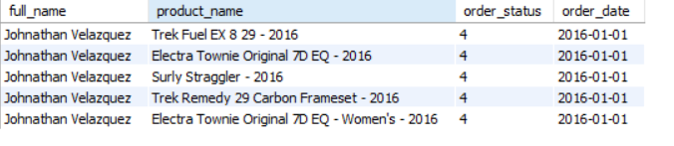
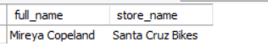
Answering Questions
10-What did the customer on question 9 buy and when? What’s the status of this order?
11-Which staff processed the order of customer 259? And from which store?
Query:
Result: Answ10: Answ11:
.

Slide 13
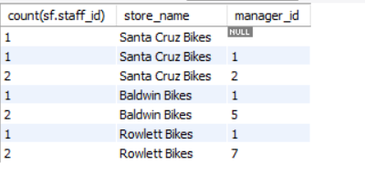
Answering Questions
12-How many staff does BikeStore have? Who seems to be the lead Staff at BikeStore?
Query:
Result: Answ12:

Slide 14
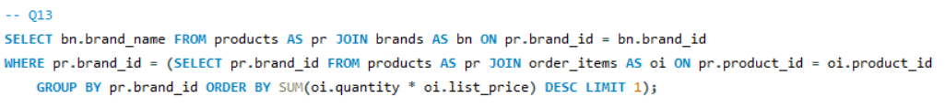
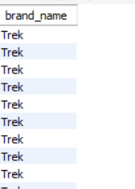
Answering Questions
13-Which brand is the most liked?
Query:
Result:

Slide 15
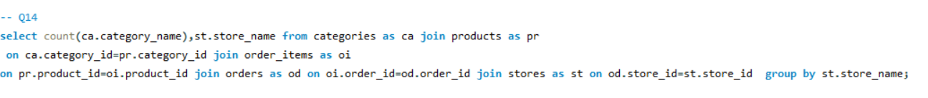
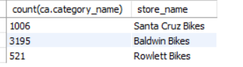
Answering Questions
14-How many categories does BikeStore have, and which one is the least liked?
Query:
Result:

Slide 16
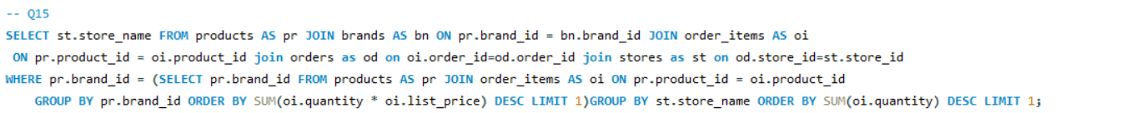
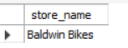
Answering Questions
15-Which store still have more products of the most liked brand?
Query:
Result:

Slide 17
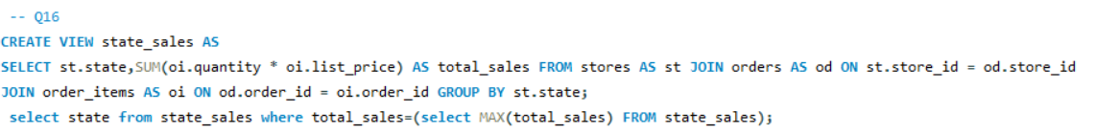
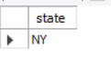
Answering Questions
16-Which state is doing better in terms of sales?
Query:
Result:

Slide 18
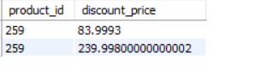
Answering Questions
17-What’s the discounted price of product id 259?
Query:
Result:

Slide 19
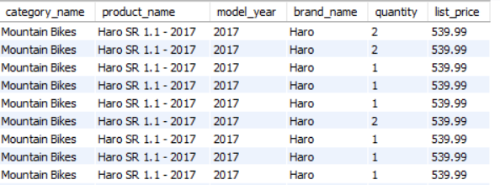
Answering Questions
18-What’s the product name, quantity, price, category, model year and brand name of product number 44?
Query:
Result:

Slide 20
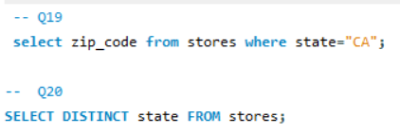
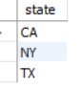
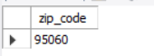
Answering Questions
19-What’s the zip code of CA?
20-How many states does BikeStore operate in?
Query:
Result: Answ19: Answ20:

Slide 21
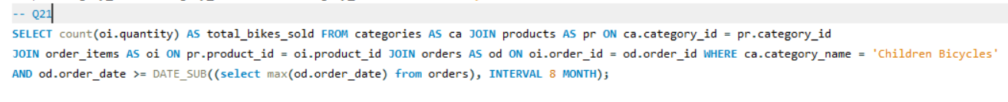
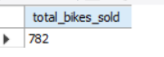
Answering Questions
21-How many bikes under the children category were sold in the last 8 months?
Query:
Result:

Slide 22
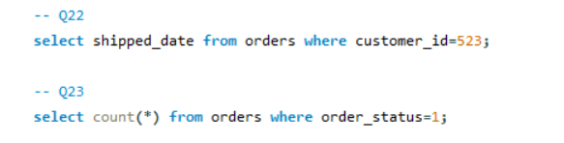
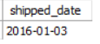
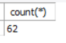
Answering Questions
22- What’s the shipped date for the order from customer 523?
23- How many orders are still pending?
Query:
Result: Answ22: Answ23:

Slide 23
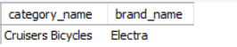
Answering Questions
24-What’s the names of category and brand does "Electra white water 3i - 2018" fall under?
Query:
Result:

Slide 24
THANK YOU

